Slide 1
GHOSTS
They are all around us...
You don’t believe it???
Then why don’t you join us on this journey....?
...they are waiting for you!!! Just click you mouse to start your Journey.
PREPARE TO BELIEVE!!!

Slide 2
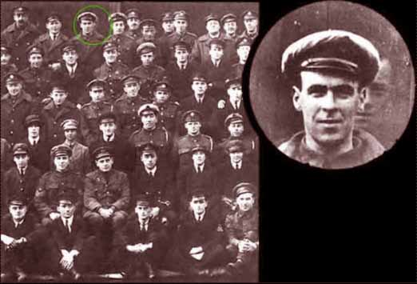
Group Captain Victor Goddard kept this rather strange picture. The photo was taken following the last mission of this group. In the photo appears the face of an airman who was killed several days before the photo was taken, when he walked into the rotating propellor of a plane. Obviously he did not want to miss out on the group photo.

Slide 3
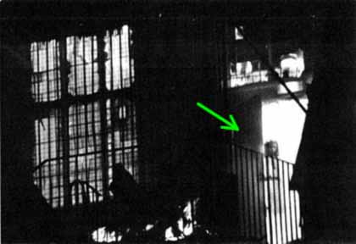
In November 1995 a fire destroyed the Town Hall of Wem in the UK.. Tony O´Rahilly, a photographer was called to the scene and took the picture above. When he developed it, he noticed the silhouette of a young boy or girl.
The ghostly shape that appears in the photo was identified as that of a young girl who in 1977 had started a large fire in the same building and perished in the flames.

Slide 4
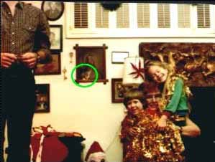
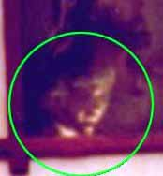
It looks like an ordinary family shot ...
But who is the person looking on in the background?

Slide 5
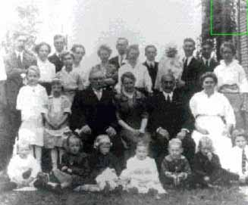
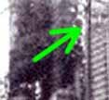
A typical family photo from the 19th Century.....
... It seems that the six year old great-great-great granddaughter who had died 2 months before the photo was taken, did not want to be left out of it!!!

Slide 6
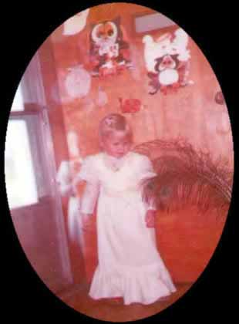
This is a photo of Tracy who was born on 13 June 1975, or to be more exact Friday the 13th. She caught meningitis and was rushed to emergency by her parents where prompt attentio saved her life. The photo was taken in 1979, nine months after, and two days following another incident that nearly took her life away again.
Can you see the "person" who is alongside Tracy? The "person" seems to have an arm around her protecting her from the back. Some say that it is just an optical effect from the lens reflection. 23 year on, Tracy says that the "person" who appears behind her could have resulted from a fault in the camera, but her parents swear it is her guardian angel.

Slide 7
The following photo was exhibited as evidence in a police investigation into a very strange incident. It resulted from the case of a man who decided to take photos in some caves (Khaimah) in spite of being warned against doing so by the local residents.
Around midday the photographer called the police, having heard horrible screams inside one of the many caverns when he was taking photos. Some hours later the police discovered the remains of the man, totally dismembered, but with his camera intact beside him.
When the police developed the film, they were shocked. For lack of further proof they decided that his death had been caused by some wild animal. Have a look at the “wild animal”...

Slide 8
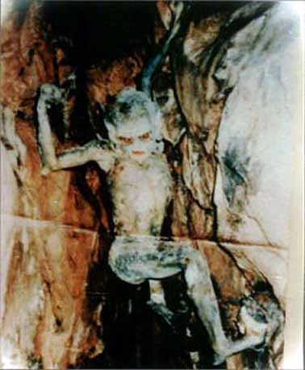

Slide 9
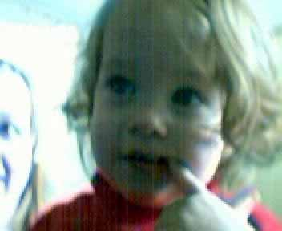
This is a photo of a young girl at one year old. It was taken on 5 May 2001 with a new digital camera... When the photo was taken, there were only two people in the house, the young girl and her mother, who took the photo, but...
...Who is that beside the girl???

Slide 10
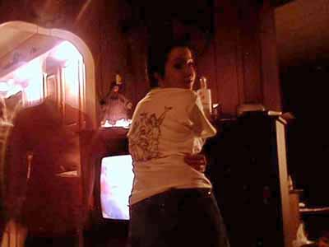
The girl in this shot thought there was nobody else on her left side...
...and do you think she is alone???

Slide 11
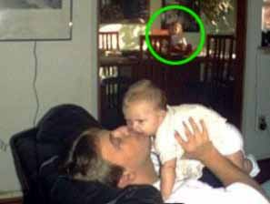
Daddy playing with his son, and Mummy taking the photo. Nobody else is in the house...
...except the girl who appears in the background!!!

Slide 12
The following photo was taken in 1985, in a large forest, where legend has it that several women, accused of being witches, were executed...
... Can you see the figure that appears between the trees

Slide 13
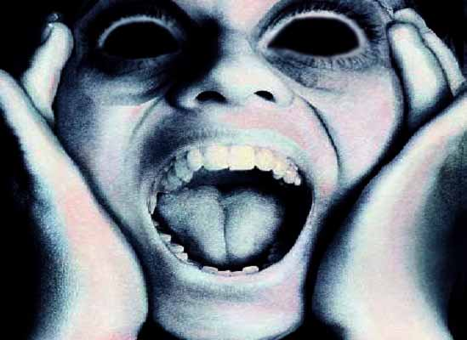
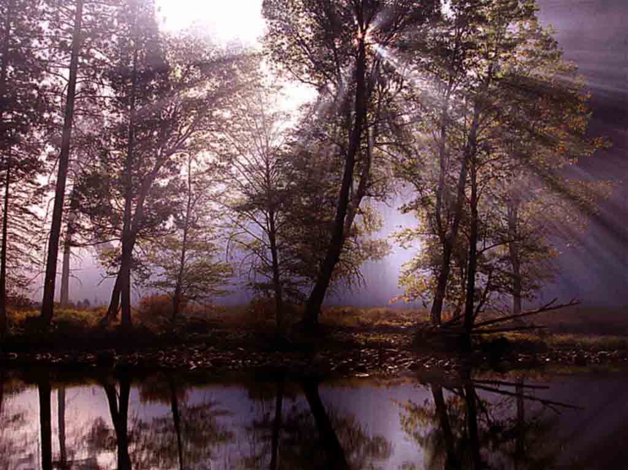

Slide 14
Whatever you may think, it is interesting! Strange things do happen...
... Do you know who is beside you!!!

