Slide 1
Night Elie Wiesel
Introduction
Background
Discussion Starters

Slide 2
Night Eli Wiesel
Images provided by Jupiter Images and Shutterstock.

Slide 3
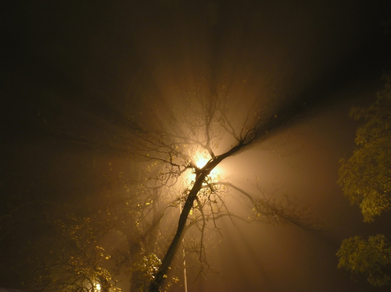
Night Elie Wiesel
Indifference to evil is evil.
—Elie Wiesel

Slide 4
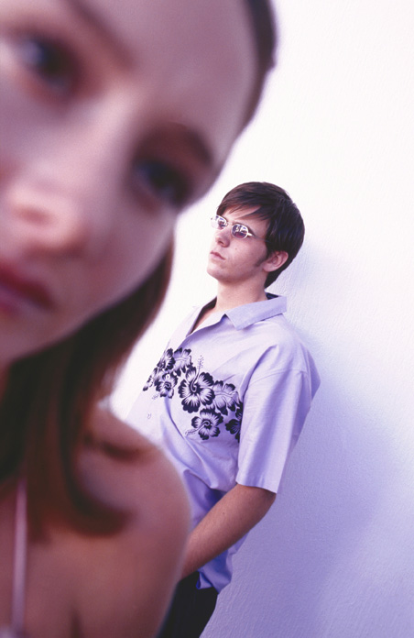
Night: Introduction
When you see something that’s wrong, do you just stand by?
Or do you act to try and stop it?

Slide 5
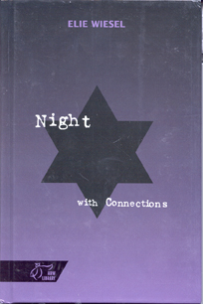
Night: Introduction
Elie Wiesel’s memoir Night describes a horrible time in the twentieth century, when too many people looked away from a terrible wrong.

Slide 6
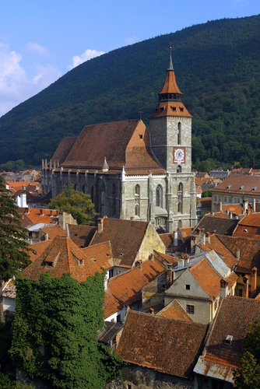
Night: Introduction
In 1941, Eliezer was a twelve-year-old boy who lived with his father, mother, and three sisters in a small village near the border of Romania and Hungary.

Slide 7
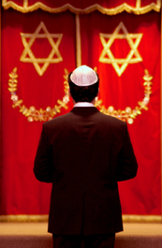
Night: Introduction
Eliezer was a religious boy who welcomed nightfall as a time for prayer and who thought of becoming a rabbi.

Slide 8
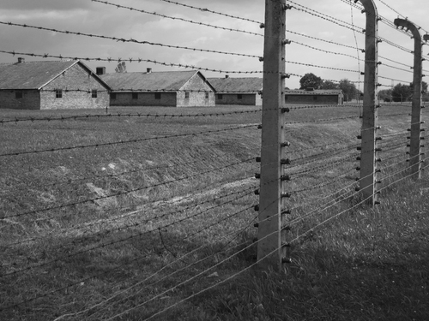
Night: Introduction
But when Nazis took over Eliezer’s Jewish community,
his family was first sent to live in a ghetto and then taken to Auschwitz, one of the most infamous concentration camps.

Slide 9
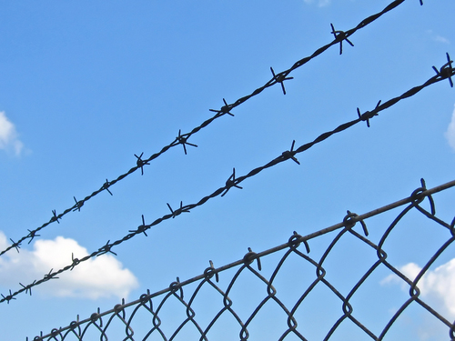
Night: Introduction
Eliezer and his father were separated from Eliezer’s mother and sisters.
He would never see his mother or his youngest sister, Tzipora, again.

Slide 10
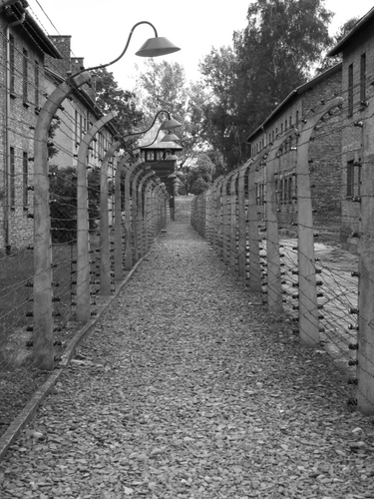
Night: Introduction
Inside the camp, Eliezer will witness horrible acts of cruelty and suffer in terrible ways.
How will he survive?
Can his religious faith endure the atrocities he witnesses?
What message does he bring to the world from such horror?

Slide 11
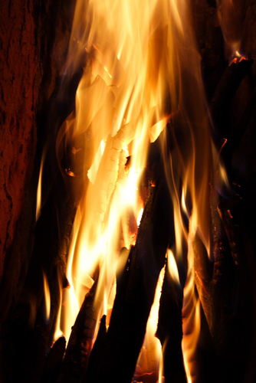
Night: Background
In Night, Elie Wiesel shares his story of the Holocaust, the name given to the persecution and murder of millions of Jews and others during World War II.
Holocaust comes from a Greek word that means “a burnt offering.”

Slide 12
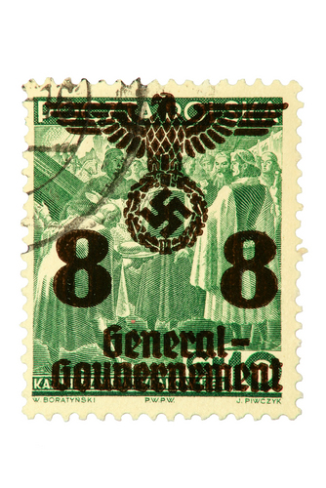
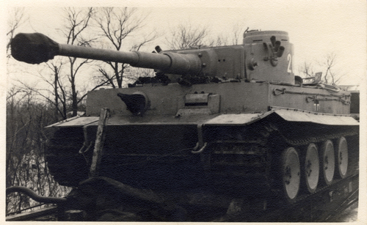
Night: Background
Germany began World War II when it invaded Poland in 1939.
German forces conquered most of Europe in the next two years.

Slide 13
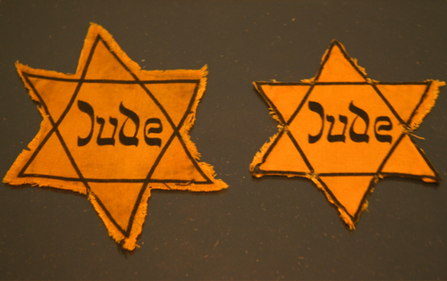
Night: Background
Wiesel’s story begins in Romania (now Hungary) in 1941 and ends in 1944. When Germans took over this area, local Jews were persecuted.
They were forced to wear yellow stars and to live in ghettos, and were then sent to concentration camps.

Slide 14
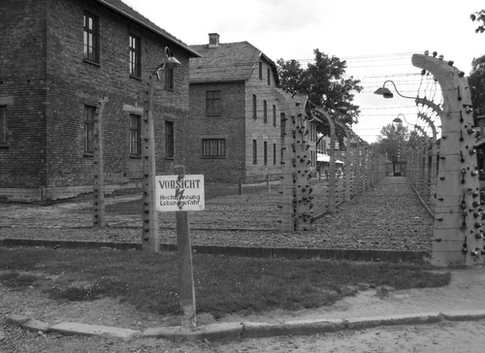
Night: Background
Auschwitz, where Wiesel was sent, was the largest camp.
Jews from all over Europe arrived almost daily at Auschwitz.

Slide 15
Night: Background
Nazis also targeted other groups:
• Romany (Gypsies)
• Russians
• non-Jewish Polish intellectual and religious leaders
• Communists
• Jehovah’s Witnesses

Slide 16
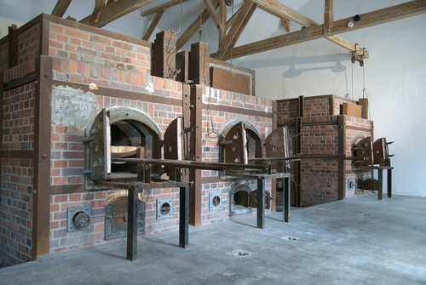
Night: Background
World War II ended in Europe in 1945 with the surrender of German forces to the Allied forces.
More than six million Jews had been killed in the Holocaust.

Slide 17
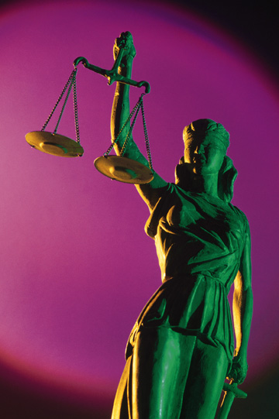
Night: Background
Between 1945 and 1946, the Allies tried twenty-two major war criminals for their crimes against humanity.
In later years Israeli agents worked to capture and bring to justice Nazis who had escaped the war trials.

Slide 18
Night: Discussion Starters
Discuss (1)
The German soldiers followed orders to persecute and murder Jews. Many people were bystanders who let the actions unfold without doing anything.
• What is the danger of blindly following the orders of others?
• Why do you think some people stand by and do nothing to help others in need?

Slide 19
Night: Discussion Starters
Discuss (2) What other genocides—attempts to kill large numbers of a group of people—have you heard or read about? • Did people ignore these genocides or try to stop them? • What do you think makes people hate members of another group?

