Slide 1
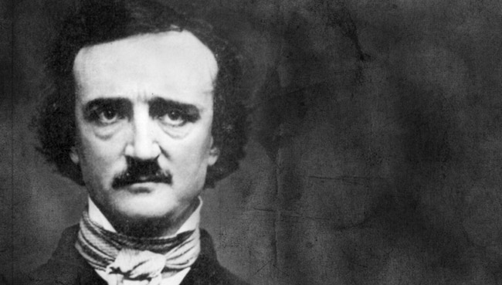
CSI
Crime Scene Investigation
Was
Edgar Allan Poe MURDERED?

Slide 2
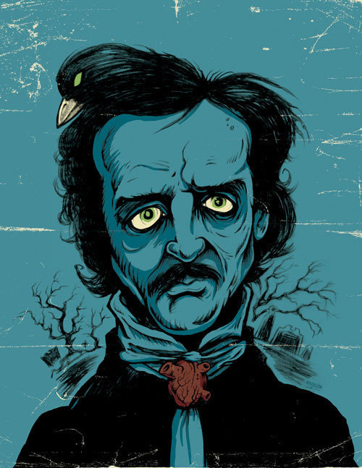
BORN
January 19th, 1809
Died
October 7th, 1849
Many mysteries surround Edgar Allan Poe’s death.

Slide 3
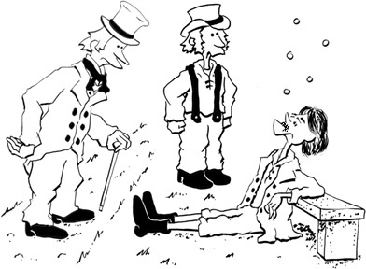
On October 3rd, 1849, Poe was found in the streets of Baltimore, MD. “in great distress, ...and in need of immediate assistance.”

Slide 4
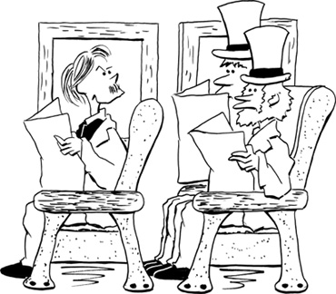
Poe was taken to Washington Medical College where he died on October 7th at 5am.

Slide 5
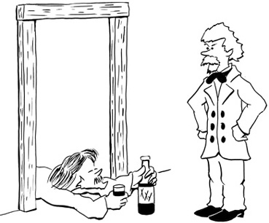
Poe was never coherent long enough to explain what happened to him.

Slide 6
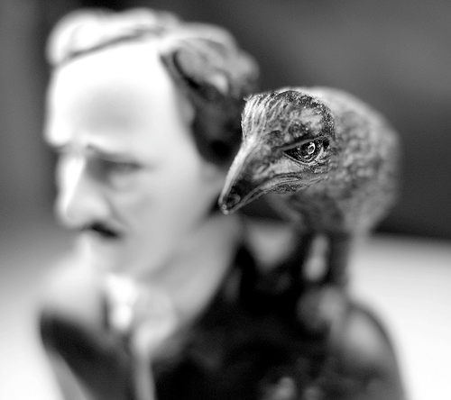
He was found wearing someone else’s clothes and repeatedly shouted out the name “Reynolds” the night before he died.

Slide 7
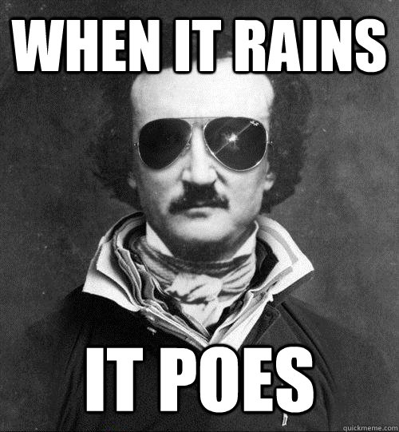
His final words were claimed to be “Lord help my poor soul.”

Slide 8
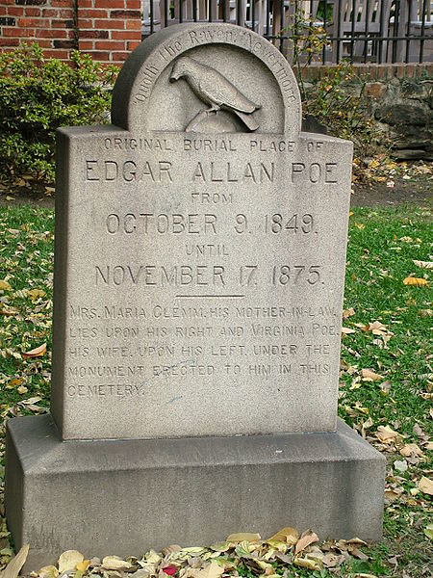
All medical records, including the death certificate, have been lost.

Slide 9
Newspapers reported Poe’s death as “congestion of the brain” or “cerebral inflammation”
Both are common terms used in place of alcoholism.

Slide 10
Common Theories on Poe’s Death
Alcohol
Brain Congestion
Cholera
Drugs
Heart Disease
Rabies
Suicide
Tuberculosis
Cooping

