Slide 1
Treaty in The media

Slide 2

George Catlin (1982)

Slide 3
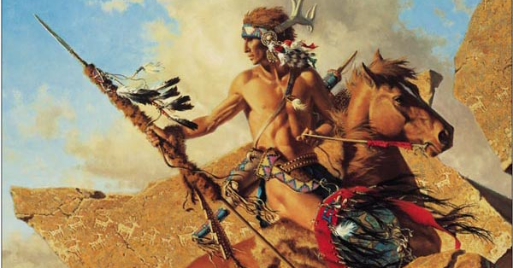
Taken from: http://www.orgsites.com/fl/navet/

Slide 4

Pocahontas. Dir mark gabriel and eric goldberg. Buena vista distribution, 1995. film.

